Slide 1
Agenda
DevOps with Azure DevOps
What is DevOps?
DevOps Lifecycle
DevOps Advantages
DevOps Tools
Who DevOps Engineer?
Azure DevOps Offering
Getting Started with Azure DevOps

Slide 2


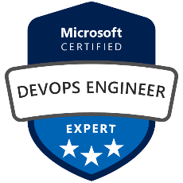

About Mentor
Founder & CEO of ScholarHat, a leading EdTech platform
A Speaker, Solution Architect and Mentor
9th Times Microsoft MVP (2016-2024)
Corporate Trainer for top MNCs: IBM, Cognizant, Dell, & more
Trained 1Lakh+ working professionals across the globe
Author of 30+ eBooks on Technical Interview Q&A
Author of 1000+ Articles on ScholarHat platform
Offering a world-class learning experience through technology & AI

Slide 3
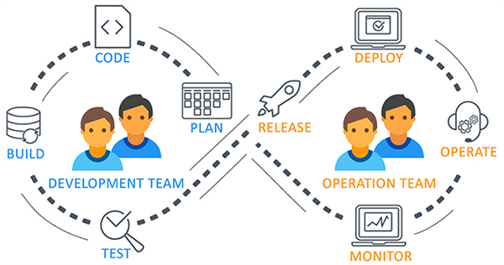
What is DevOps?
DevOps is a set of practices that combines people, processes, and tools to provide continuous delivery of value to customers.
In other words, DevOps is a software development and delivery method which focuses on the automation of processes from coding and deployment, to maintenance and updates.

Slide 4
Need of DevOps
In traditional process, the development and operation were isolated activities.
Team members spend a lot of time in testing, deploying, and designing instead of building the project.
Manual code deployment leads to errors in production.
Development and operation teams have their own timelines. Usually separate timelines are not in sync which cause further delays in delivery.

Slide 5
DevOps Lifecycle
Planning
Monitoring
Development
Continuous Delivery
Release & Deployment
Testing
Integration
Notes:
Implement full stack monitoring, get actionable alerts and gain insights from logs and telemetry with Azure Monitor. Manage your cloud environment with Azure Automation and tools such as Ansible, Chef, or Puppet.
Keep provisioned infrastructure and applications in compliance with Azure Blueprints or Chef Automate. Used with Azure Security Center, you’ll limit threat exposure as well as find and remediate vulnerabilities quickly.

Slide 6
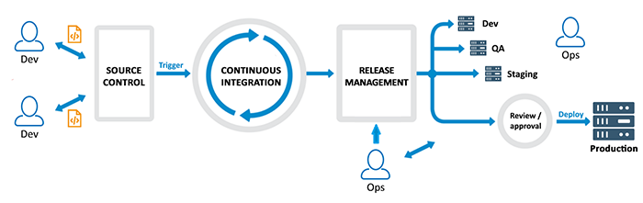
How DevOps Works?

Slide 7
DevOps Advantages
Faster releases through CI/CD.
More engaged and collaborative Dev and Operation teams.
Faster operational support.
Less failures and continuous improvement.
Transparency between the Dev and Operation teams.
Constant monitoring and better adaption.
Increase efficiency.

Slide 8
DevOps Tools
Tools for Planning
Azure Boards
Jira
Tools for Code Management
Git
TFVC
Tools for Testing Automation
Azure Test Plans
Selenium
JMeter
Tools for Build
Azure Pipelines
Ant
Maven
Tools for CI/CD
Azure Pipelines
Jenkins
TeamCity
Tools for Configuration
ARM Templates
Terraform
Chef
Ansible
Tools for Monitor
Application Insight
Splunk
Nagios

Slide 9
Who is DevOps Engineer?
A system administrator who also knows how to write code
A developer who knows the basics of system administration
An engineer who can be a full time system administrator and full-time developer for only the cost of one salary.

Slide 10
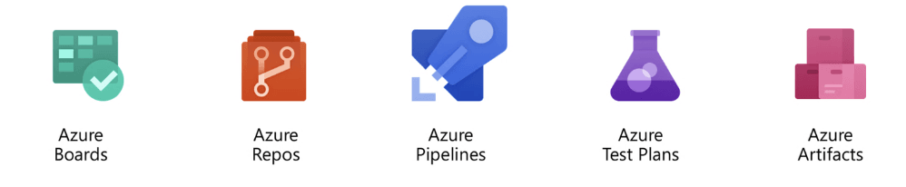
Introduction to Azure DevOps
Formally known as VSTS (Visual Studio Team Services).
Provides full application lifecycle management from planning to coding, and from testing to build and deployment.
Offers CI/CD for every team, every app and every platform.

Slide 11
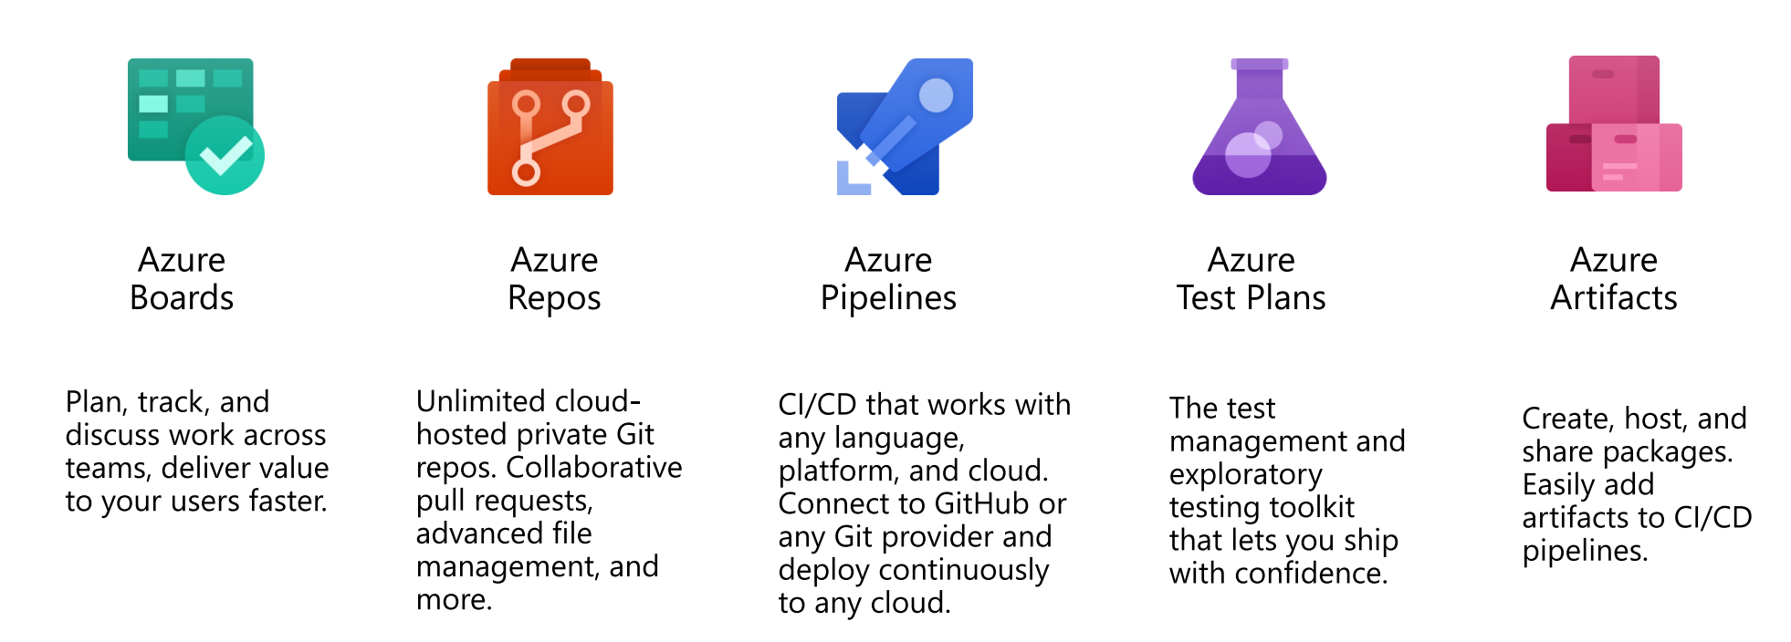
Azure DevOps Offerings

Slide 12

DevOps with Azure DevOps
Agile Planning
Dashboards
Kanban Boards
Task boards
Monitoring
Telemetry
Diagnostics
Analysis
Monitor + Learn
Plan + Track
Continuous
Delivery
Build and Test
Git Source Control
Modern Code Workflow
Continuous Integration
Continuous Testing
Package Management
Open Source Compliance
Release
Delivery
Deployment of app and infrastructure
PaaS, IaaS and Containers
Develop + Test

Slide 13
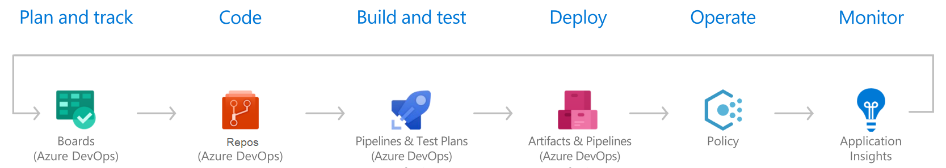
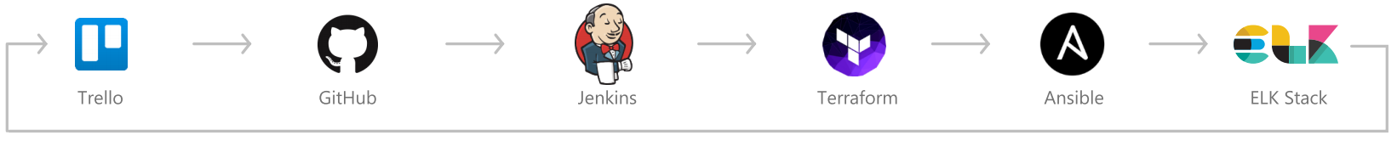
Azure DevOps and Third Party Tools
Notes:
You can mix the Microsoft and third party tools together to implement devops

Slide 14



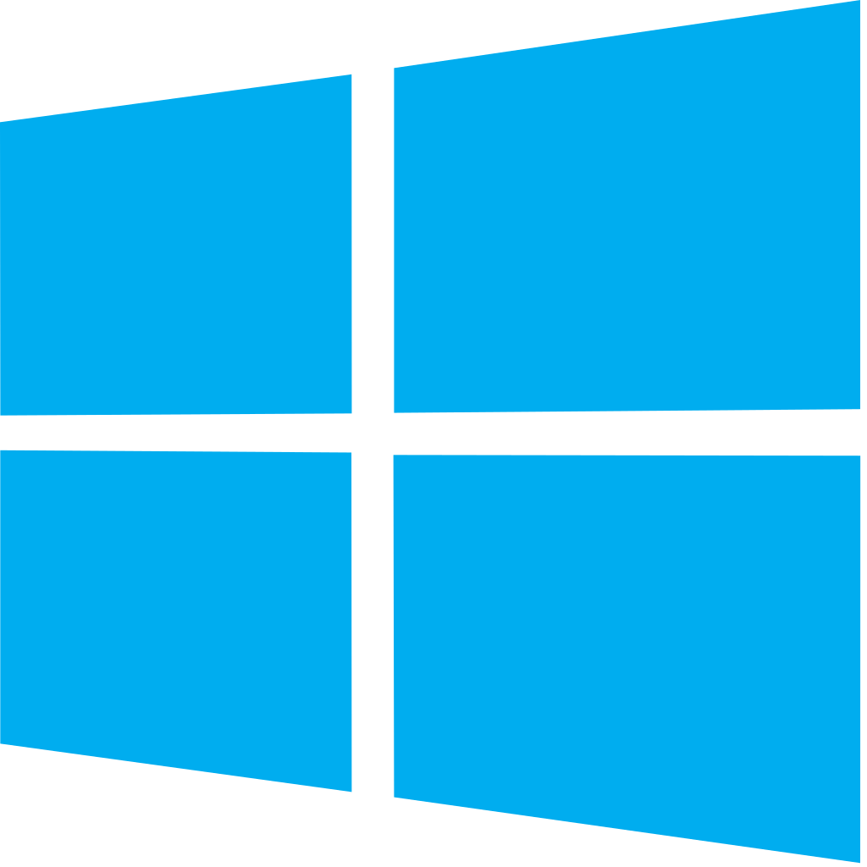
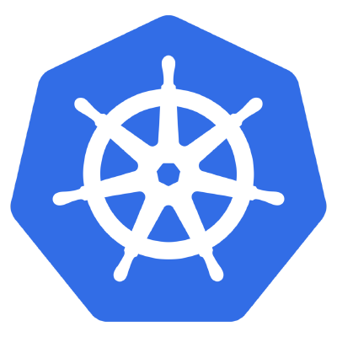
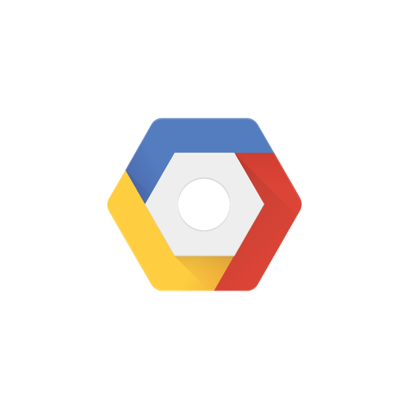
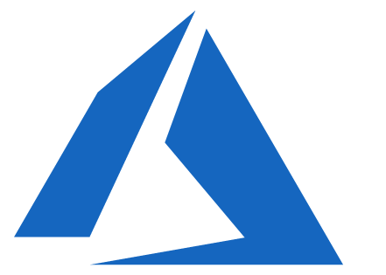

Azure DevOps Platform Supports

Slide 15
Azure DevOps Services vs. Azure DevOps Server
TFS is now Azure DevOps Server and Visual Studio Team Services is now Azure DevOps Services.
Both provide the same essential services, but Azure DevOps Services offers a cloud platform whereas Azure DevOps Server is the on-premises server.
Although both work similarly, Azure DevOps services provide benefits like simplified server management, access to the latest release immediately and remote site connectivity, etc.
Notes:
Many organizations want their data on their server so they can choose the Azure DevOps Server.

Slide 16
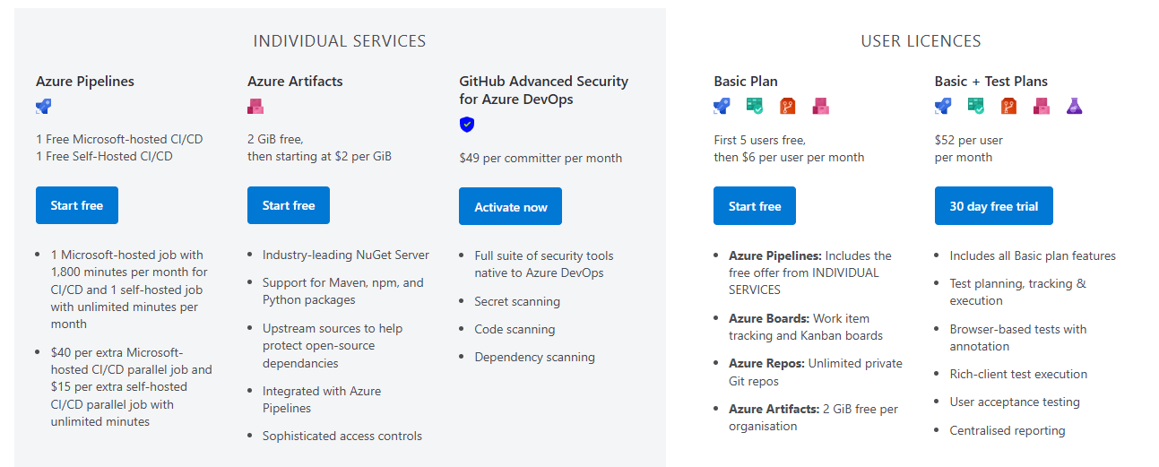
Azure DevOps Services Pricing
Source: www.azure.microsoft.com/en-us/pricing/details/devops/azure-devops-services
Notes:
Get started for free for small teams, scales to support the largest enterprises
Use all the Azure DevOps services or choose just what you need to complement your existing workflows.
Best in class builds for open source. Free unlimited build minutes for public projects and up to 10 free concurrent jobs across Windows, Linux and macOS

Slide 17
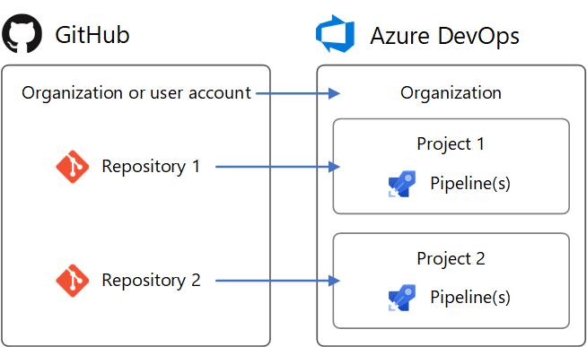
Azure DevOps
https://aex.dev.azure.com/

Slide 18
User Access Level
Stakeholder: Provides partial access and can be assigned to unlimited users for free. Assign to users who need access to a limited set of features.
Basic: Provides access to most features. Assign to users with a Visual Studio subscription, an Azure DevOps Server CAL, and to users for whom you're paying for Basic access in an organization.
Visual Studio subscription: Assign to users who already have a Visual Studio subscription. If you assign Basic or Stakeholder, they also receive their Visual Studio subscription benefits upon sign-in.
Notes:
CAL - Client Access License

Slide 19
Azure Dashboard
Used to access important information related to Works Assigned, Build History, and Test Plans.
Supports Customized widgets to provide deep inside of your project and progress workflow.
Supports Charts, Widgets, reports, and Integration with Power BI.

Slide 20
Azure Wiki
Wiki makes your documentation work easy.
Team members collaborate and work together to create project documentation, user manuals, functional documents, technical documents etc.
Used to explain project Vision, epics, specifications, release notes, coding standards and best practices or other content with team members and stakeholders to learn

